Slide 1

SRMKZILLA MOZOHACK 2021
THE SUSTAINABLE STORE
TEAM TESSERACT
SRM INSTITUTE OF SCIENCE AND TECHNOLOGY - KTR
Bhairav Phukan
Sadhavi Thapa
Keegan Paul Colaco
Grahil Agarwal

Slide 2

Problem Statement:
“Ways of containing and recycling Digital waste so that it does not become the next threat as plastic is to environment.”

Slide 3
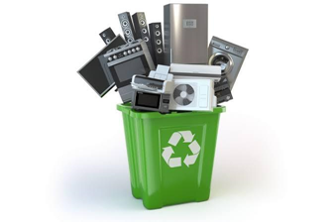

Innovative Solution:
The Sustainable store is an online platform where the users can earn points by giving out their E-waste to our store officials. The points earned can be used to buy recycled products from our website which is made from e-waste collected from our users. We have also used an ML model to classify if the given waste material is classified as E-waste or not which will help to raise awareness of waste recycling.

Slide 4
Methodology
The user has to upload a picture and our ML model will classify the waste. If the waste is classified as E-waste, a request for E-waste pick up will be generated and waste can be collected from user’s house.
The user earns points based on the type and amount of E-waste collected.
After E-waste collection the users can use the earned points to shop for recycled products made from e-waste from our Sustainable store.

Slide 5
Market opportunities & Applications :
Making recycled products made from digital waste available for purchase.
Can generate mode of employment.
Increasing awareness among people, hence they trying to do their part by buying and using recycled products.
Currently there is no actual e-commerce structure to get e-waste from people to get it recycled on a large scale.
Constant collection and recycling of digital waste will help us fight the climate crisis.

